Slide 1

Williams International Digital Transformation
Building an Internal Data Platform

Slide 2
Agenda
Organization/Industry Description
Current State of Resources
Problem Description/Research Question
Method
Deliverables/Findings
Research Evaluation
Lessons Learned
Future Work and Conclusion

Slide 3
Organization/Industry Description
Competitive Aerospace industry with global giants like: Pratt & Whitney, Rolls-Royce, and GE Aerospace
Williams International needs to bridge the gap between itself and its larger competitors
Company | 2023 Revenue | Estimated Number of Employees
Pratt & Whitney | ~$23.7 billion | ~43,000
Rolls-Royce | ~$16.67 billion | ~50,000
GE Aerospace | ~$26 billion | ~52,000
Williams International | Not publicly disclosed | ~1,000
Notes:
No business is in the business of not making more money

Slide 4
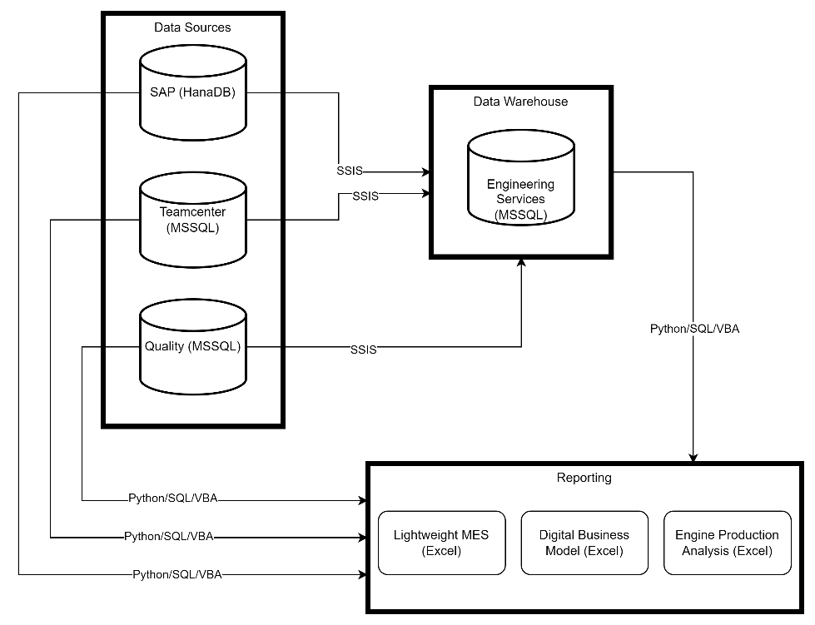
Current State
All reporting is done directly on production databases using Python, SQL, and VBA
Data is seldomly pulled into a data warehouse
Data warehouse is less than live being updated only once per day at most by IT

Slide 5
Problem Description/Research question
How can Williams International design an integrated data platform that can handle unstructured, semi-structured, and structured data?
Remove siloed data sources
Handle complex and modern data types
Migrate legacy data trapped in unstructured formats
Enforce data governance and quality
Make integration and interoperability a first-class feature

Slide 6
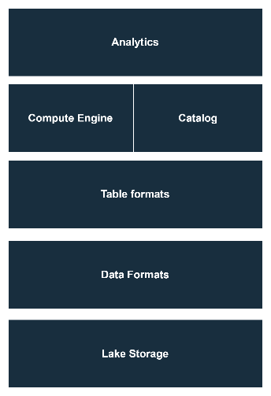
Method: What is a Data Lake?
A Data Lake is a centralized storage system that holds raw data from various sources in its native format; structured (RDBMS), semi-structured (JSON), and unstructured (images or videos).
As Williams International works towards implementing a Data Lake, it should integrate what already exists from the data warehouse. The main point of the Data Lake is the ability to ingest more data from more sources.
(Amazon Web Services, n.d.).
Notes:
No business is in the business of not making more money

Slide 7
Method: Why Not Extend the current Implementation?
Is the organization generating or receiving data beyond the structured formats typically stored in a data warehouse?
The current data warehousing scheme exclusively implements SQL Server. As a RDBMS, SQL Server is not fit to handle modern and complex data types (JSON, XML, binary files, etc).
As Williams International branches out into more web-based communication using protocols such as REST, they need to extend data storage capabilities to handle this.
Does the organization struggle with siloed data across systems?
Williams International deeply struggles with mission critical reporting being siloed inside of an excel spreadsheet. Directors of business units are forced to wait more than 30 minutes for their reports to update.
A Data Lake, implemented correctly, aims to address this issue by serving as the central repository for production data, eliminating redundancy and silos.
Notes:
No business is in the business of not making more money

Slide 8
Deliverables and Findings: Part 1 of 4
Business Requirements
Functional Requirements
Comply with ITAR regulations
Provide a cost-benefit justification aligned with business goals
Address current and future data demands effectively
Support unstructured, semi-structured, and structured sources
Enable data governance and quality assurance processes
Integrate mission-critical systems to eliminate data silos
Facilitate real-time and historical data processing for analytics

Slide 9
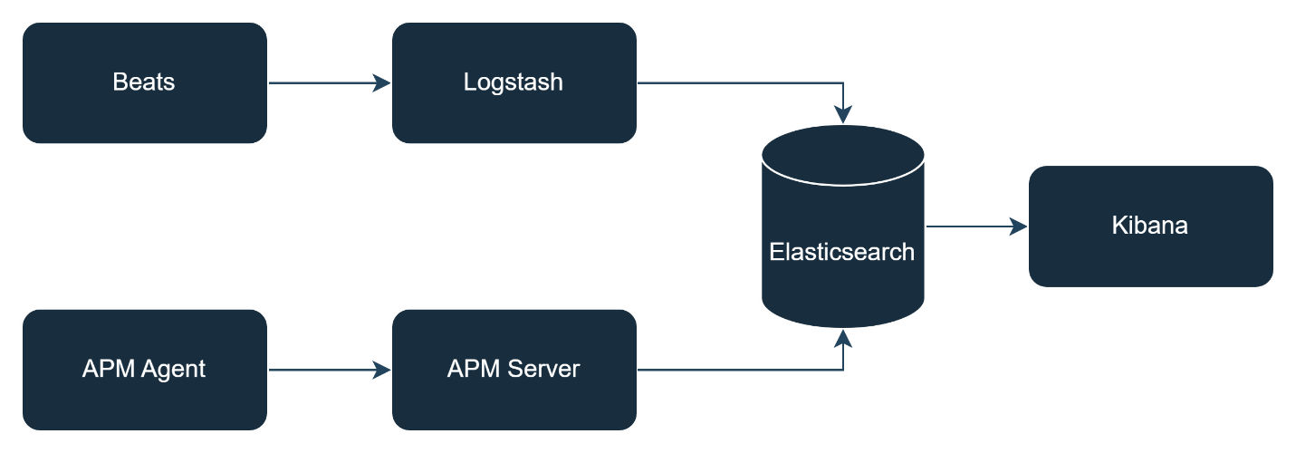
Deliverables and Findings: Part 2 of 4
Solution 1: Elastic On-Premises Data Platform

Slide 10
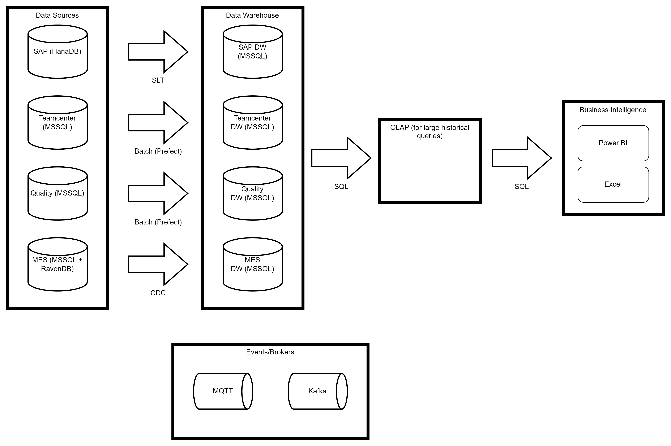
Deliverables and Findings: Part 3 of 4
Solution 2: Custom On-Premises Data Platform

Slide 11
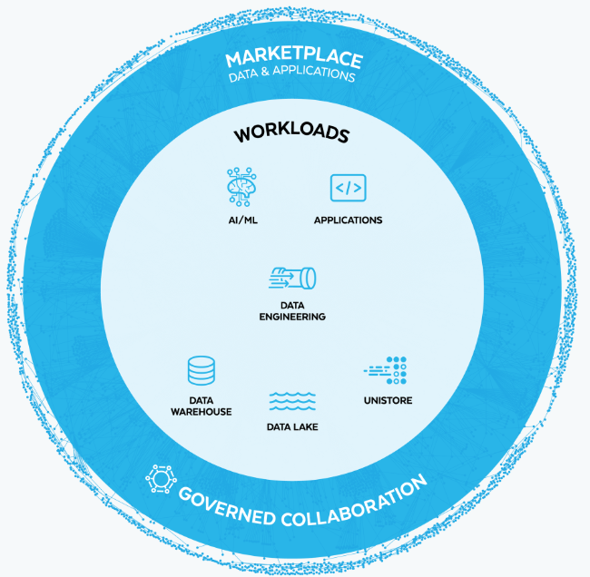
Deliverables and Findings: Part 4 of 4
Solution 3: Snowflake Cloud Data Platform

Slide 12
Research Evaluation: Part 1 of 6
Solution 2 allows for the exploration and customization of an on-premises architecture tailored to Williams International’s unique requirements. This provides an opportunity to test and showcase the feasibility, scalability, and effectiveness of a bespoke solution, offering deeper insights into how it can be integrated into the organization’s existing systems and workflows.
Notes:
No business is in the business of not making more money

Slide 13
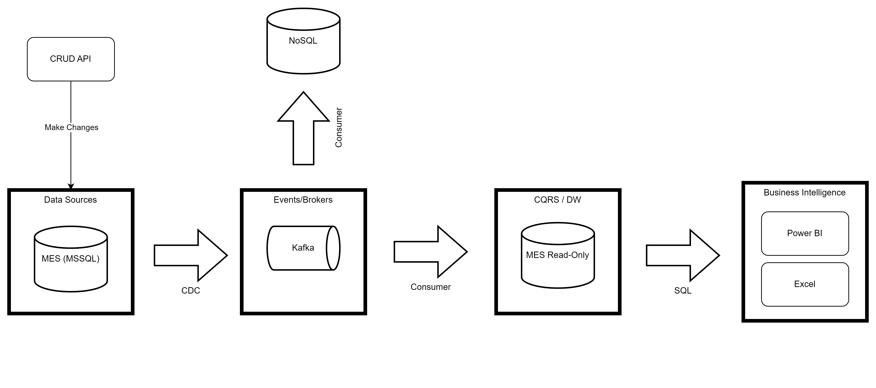
Research Evaluation: Part 2 of 6
Notes:
No business is in the business of not making more money

Slide 14
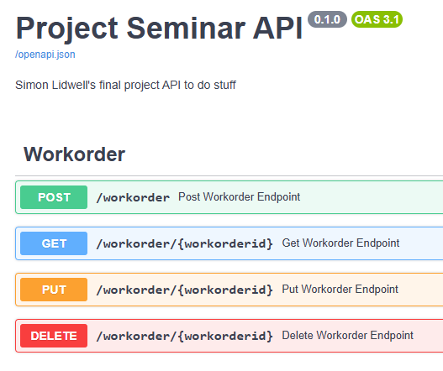
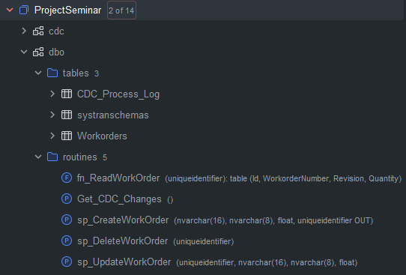
Research Evaluation: Part 3 of 6
Notes:
No business is in the business of not making more money

Slide 15
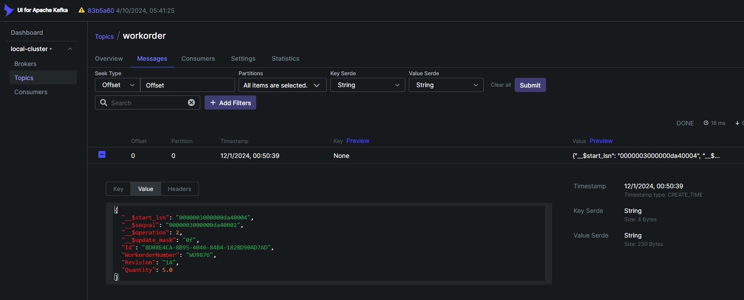
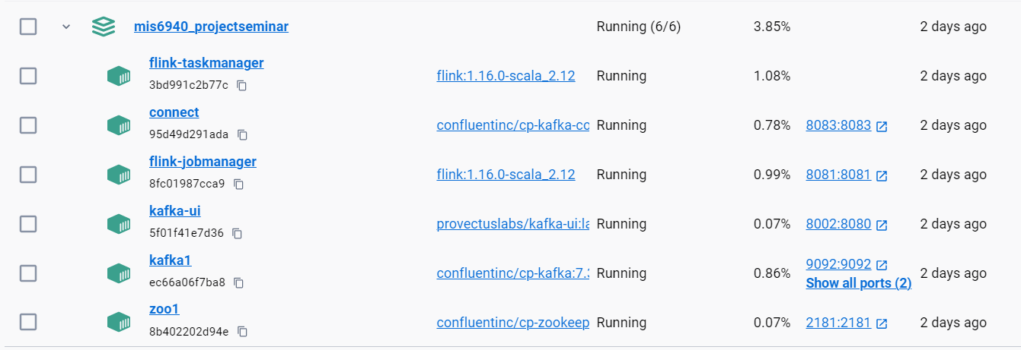
Research Evaluation: Part 4 of 6
Notes:
No business is in the business of not making more money

Slide 16
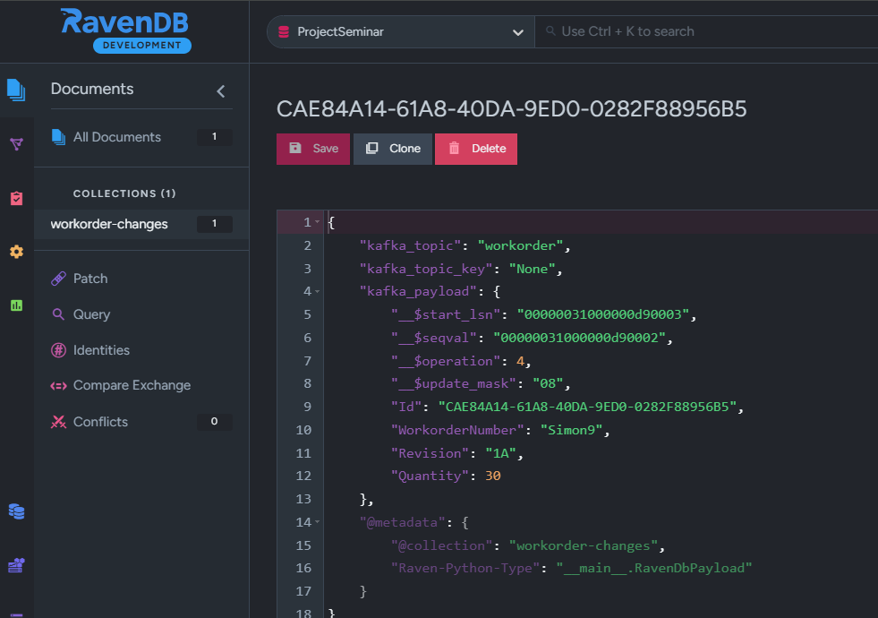
Research Evaluation: Part 5 of 6
Notes:
No business is in the business of not making more money

Slide 17
Research Evaluation: Part 6 of 6
Notes:
No business is in the business of not making more money

Slide 18

Thank You
slidwell@oakland.edu

